Slide 1
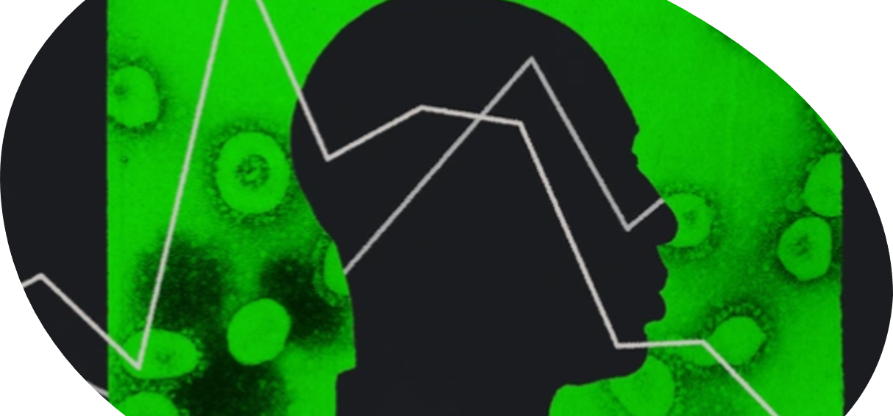
Women Who Code - Mission: Predictable
A Virtual Machine Learning Hackathon to Battle Covid-19
Sharonda Pettiett-Warner and Omega Markos

Slide 2

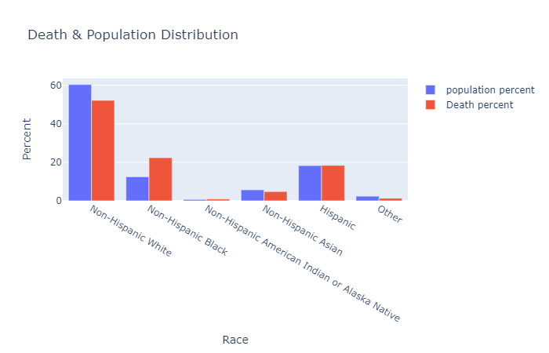
Problem Statement
COVID-19 is impacting the black communities disproportionately in the U.S.
Blacks are dying at a rate higher than all others races in America:
Death percent for Blacks is 22%, while the share of the Black population 13% (as of July 22, 2020)
Our goal, was to use machine learning techniques to uncover insights into the .... Why?...
And find out, if ... Disasters do Discriminate…
Notes:
COVID-19 is a global crisis impacting millions of people world-wide. Specifically in the US, the disparities between the size of the black population and the percentage of black people infected with, hospitalized with, or dead from COVID-19 appear to be the most severe.
To battle this inequality our team has chosen to build an unsupervised machine learning model using K-means clustering to perform population segmentation and use dimensionality reduction techniques like PCA to evaluate a large number of features. These features, include US Census Data; US COVID-19 cases, deaths and policies to help us discover new trends and patterns in solving this crisis impacting the black communities in the US.
COVID-19 Death Rates Higher in Blacks | Blacks are dying at a rate higher than all others races in America
The share of the Black population is 13%, while the deaths for Blacks is 22% (as of July 22, 2020)

Slide 3
technologies & models
Used Python programming language
Performed data visualization using Plotly, a Python graphing library to make interactive graphs
Used unsupervised machine learning methods, such as:
PCA, a dimensionality reduction technique
K-means clustering, a machine learning algorithm
Our machine learning approach included demonstrating the following tasks:
How to build PCA and K-means clustering training models using Sklearn libraries
How to build and deploy PCA and K-means clustering training models using AWS Sagemaker
Notes:
Used unsupervised machine learning and dimensionality reduction techniques to identify clusters within the datasets to learn, from the properties of the data.
Our machine learning approach included performing the following key tasks:
Demonstrating how to build PCA and K-means clustering training models using Sklearn libraries
Demonstrating how to build and deploy PCA and K-means clustering training models using AWS Sagemaker

Slide 4
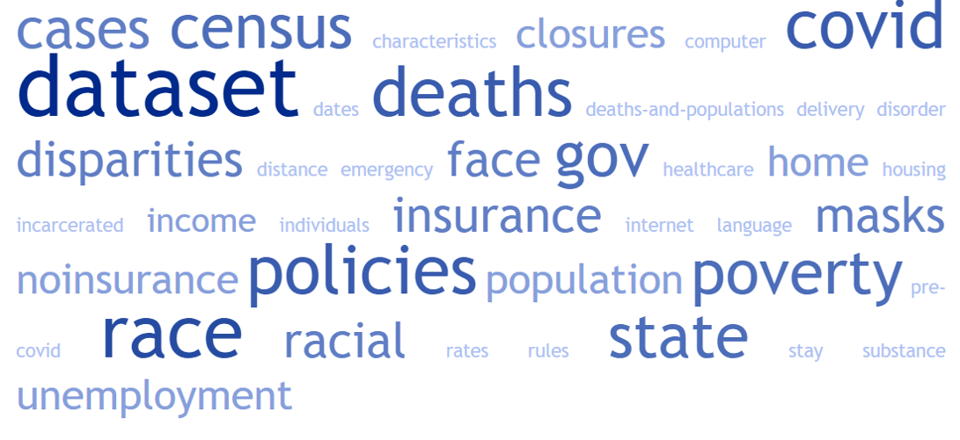
18 Data Files | 246 Attributes
Our team analyzed COVID-19 policies, cases and deaths by state and race using the most recent U.S. Census data
Notes:
Mined 18-different datasets

Slide 5
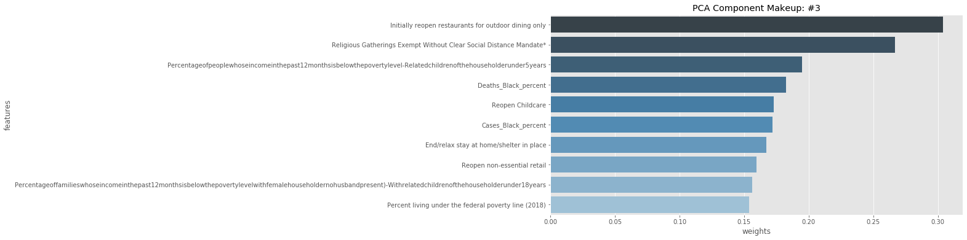
Dimensionality reduction
Reduced the attributes into (5) PCA components using Amazon SageMaker prebuilt algorithm
Examined the makeup of each PCA component based on the weightings of the original features
PCA Component : #3 describes attributes of states that have high Black Deaths and Cases
Notes:
Since we had 228 attributes in our original dataset, the large feature space may have made it difficult to cluster the states effectively. Instead, we reduced the feature space to 5 PCA components and implemented K-means algorithm to create (4) clusters.
Principal Component Analysis (PCA) is an unsupervised learning algorithm that attempts to reduce the dimensionality (e.g., number of features) within a dataset while still retaining as much information as possible.

Slide 6
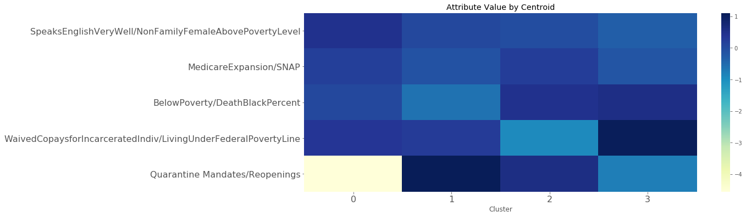
Combining PCA and clustering
PCA 1 ->
PCA 2->
PCA 3->
PCA 4->
PCA 5>
Used Amazon SageMaker, K-means to cluster the characteristics of different States and segment them into groupings
Plot a heatmap of the clusters against the PCA components
Evaluated the insights of each cluster centroid represented in terms of the PCA components
Notes:
Using unsupervised learning, we clustered a dataset using K-means after reducing the dimensionality using PCA. By accessing the underlying models created within Amazon SageMaker, we were able to improve the explainability of our modelling and draw actionable conclusions. Using these techniques, we have been able to better understand the characteristics of different states in the US and segment them into groupings accordingly.
Plot a heatmap of the centroids and their location in the transformed feature space. This gives us insight into what characteristics define each cluster. Often with unsupervised learning, results are hard to interpret. This is one way to make use of the results of PCA plus clustering techniques together. Since we were able to examine the makeup of each PCA component, we can understand what each centroid represents in terms of the PCA components that we intepreted previously.
For example, we can see that cluster 1 has the highest value in the “Quarantine Mandates/Reopenings” attribute while it has the lowest value in the “BelowPoverty/DeathBlackPercent” attribute compared with other clusters.
Please note:
PCs are arrays of projections of the features on each principal component.
PCA does not "discard" or "retain" any of your pre-defined features (encoded by the columns you specify). It mixes all of them (by weighted sums) to find orthogonal directions of maximum variance.
PCA loadings are the coefficients of the linear combination of the original variables from which the principal components (PCs) are constructed.
The columns of the dataframe contain the eigenvectors associated with the first two principal components. Each element represents a loading, namely how much (the weight) each original variable contributes to the corresponding principal component.
Another useful way to interpret PCA is by computing the correlations between the original variable and the principal components. How can we do that?
To compute PCA, available libraries first compute the singular value decomposition (SVD) of the original dataset
X=USV⊤X=USV⊤The columns of VV contains the principal axes, SS is a diagonal matrix containing the singular values, and the columns of UU are the principal components scaled to unit norm.

Slide 7
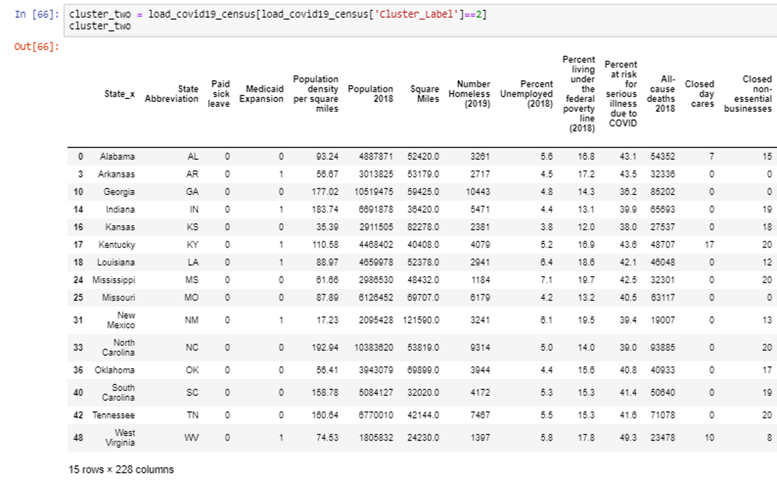
Cluster analysis
From our cluster analysis, Cluster 2 had the Highest -Black Deaths and Cases, and the key findings in this cluster are:
High – Percent Unemployment
High - At Risk for serious illness due to COVID-19
High - Households: Income Below Poverty Level
High - Living under federal poverty line as of 2018
2nd Highest – Percent Population with No Health Insurance Coverage
End/Relax stay at home policies early
Participate in the re-opening mandates
Lowest – Percent of household with Internet at Home
Lowest – Paid Sick Leave
Notes:
K-means is a clustering algorithm that identifies clusters of similar states based on their attributes; We can also map the cluster labels back to each individual state and examine which states were naturally grouped together.
__
Using unsupervised learning, we clustered a dataset using K-means after reducing the dimensionality using PCA. By accessing the underlying models created within Amazon SageMaker, we were able to improve the explainability of our modelling and draw actionable conclusions. Using these techniques, we have been able to better understand the characteristics of different states in the US and segment them into groupings accordingly.
__
In our analysis of the all of the clusters, we found that Cluster 2 best described how blacks in these states were being impacted by COVID-19. This process revealed new features strongly associated with this segmentation, such as, high poverty, high Black deaths and cases, high indicators for ending stay at home policies and initiating re-opening mandates.
Key Findings
41.4% At Risk for serious illness due to COVID-19 (highest)
15.47% Households: Income Below Poverty Level (highest)
32.39% Deaths_Black (highest)
18.4% Cases_Black (highest)
15.6% Living under federal poverty line as of 2018 (highest)
Did not stay at home; Had to participate in the reopenings
Has high Black Death Percent
Below Poverty
Living under Federal Poverty Line

Slide 8
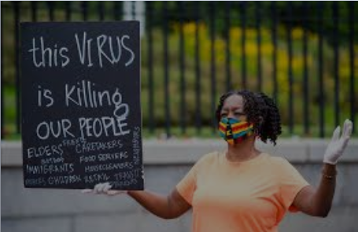
Social Impact
Our analysis reveals a link between race, poverty, cases and deaths in America
... Do Disasters Discriminate? …
By Government Policies
Ending/Relaxing stay at home measures
Initiating early business re-opening
Obtaining health insurance
Obtaining paid sick leave
By Socioeconomic Issues
Living under Federal Poverty Line
Unemployment
Access to Internet
(Yes)
Notes:
The data and our analysis on how COVID-19 is impacting the black communities disproportionately in the United States reveals a link that’s hard to ignore between race, poverty, cases and deaths in America.
Our analysis demonstrates the following features that are impacted:
by Government Policies
Relaxing stay at home measures
Initiating early business re-opening
Obtaining health insurance
Obtaining paid sick leave
by Socioeconomic Issues
Living under Federal Poverty Line
Unemployment
Access to Internet
These factors also indicate an infrastructure issue in America and the need for having a National Policy on Health Care and Income Inequities.

Slide 9
Solution
Call for a National policy on Health Care and Income Inequities which include:
Protective policies for workers
Paid sick leave
Provision of health insurance
Close the income inequality gap
During the pandemic:
Increase access to testing, PPE and education
Support for food assistance
Make available relief funds to the communities most in need
Collect more COVID-19 data by race
Notes:
Our recommendations involve having meaningful actions to support these communities and protect public health could include protective policies for workers, including paid sick leave and provision of health insurance. For high poverty and unemployment policymakers should work to address minimizing the income inequality gap.
During the pandemic to address poverty and unemployment we need to identify the black populations which need additional access to resources such as testing, personal protective equipment, education, and support to implement recommended social distancing practices; support food pantries and meal delivery services for food assistance; and relief funds are available to the communities most in need by streamlining application processes and allowing for extensions of subsidies when the crisis begins to subside.

Slide 10
Next steps
Continue to data mine more datasets and re-build our model when more data is available.
Build a SIR model for forecasting the Spread of Disease in high risk communities.
Notes:
An SIR model is an epidemiological model that computes the theoretical number of people infected with a contagious illness in a closed population over time:
s(t) = S(t)/N,the susceptible fraction of the population,i(t) = I(t)/N,the infected fraction of the population, andr(t) = R(t)/N,the recovered fraction of the population.

Slide 11
Thank you
Women Who Code, Non-profit organization
Amazon Web Services, IT service management company
Kesha Williams, A Cloud Guru
Notes:
We would like to Thank ….
Women Who Code, Non-profit organization (for sponsoring the Code Challenge)
Amazon Web Services, IT service management company (providing the AWS credits)
Kesha Williams, A Cloud Guru (Our Guru, for getting us excited about this project, Thanks!)

Slide 12
Questions & Answers
Notes:
Acknowledgements
Women Who Code, Non-profit organization
Amazon Web Services, IT service management company (providing the AWS credits)
Kesha Williams, A Cloud Guru (Our Guru, for getting us excited about this project, Thanks!)

Slide 13

Our Team
Notes:
Our Team
Omega Markos and Sharonda Warner

Slide 14
Problem Statement
COVID-19 is impacting the black communities disproportionately in the U.S.
Use machine learning techniques to uncover insights into the .... Why?...
And find out, if ... Disasters do Discriminate.
Notes:
COVID-19 is a global crisis impacting millions of people world-wide. Specifically in the US, the disparities between the size of the black population and the percentage of black people infected with, hospitalized with, or dead from COVID-19 appear to be the most severe.
To battle this inequality our team has chosen to build an unsupervised machine learning model using K-means clustering to perform population segmentation and use dimensionality reduction techniques like PCA to evaluate a large number of features. These features, include US Census Data; US COVID-19 cases, deaths and policies to help us discover new trends and patterns in solving this crisis impacting the black communities in the US.
COVID-19 Death Rates Higher in Blacks | Blacks are dying at a rate higher than all others races in America
The share of the Black population is 13%, while the deaths for Blacks is 22% (as of July 22, 2020)

Slide 15
Problem Statement
COVID-19 is impacting the black communities disproportionately in the U.S.
Blacks are dying at a rate higher than all others races in America:
Death percent for Blacks is 22%, while the share of the Black population 13% (as of July 22, 2020)
Our goal, was to use machine learning techniques to uncover insights into the .... Why?...
And find out, if ... Disasters do Discriminate…
Notes:
COVID-19 is a global crisis impacting millions of people world-wide. Specifically in the US, the disparities between the size of the black population and the percentage of black people infected with, hospitalized with, or dead from COVID-19 appear to be the most severe.
To battle this inequality our team has chosen to build an unsupervised machine learning model using K-means clustering to perform population segmentation and use dimensionality reduction techniques like PCA to evaluate a large number of features. These features, include US Census Data; US COVID-19 cases, deaths and policies to help us discover new trends and patterns in solving this crisis impacting the black communities in the US.
COVID-19 Death Rates Higher in Blacks | Blacks are dying at a rate higher than all others races in America
The share of the Black population is 13%, while the deaths for Blacks is 22% (as of July 22, 2020)

